Slide 1
Software Metrics

Slide 2
Software process and product metrics are quantitative measures that enable software people to gain insight into the efficacy of the software process and the projects that are conducted using the process as a framework.
Basic quality and productivity data are collected. These data are then analyzed, compared against past averages, and assessed to determine whether quality and productivity improvements have occurred.

Slide 3
MEASURES, METRICS, AND INDICATORS
Measure provides a quantitative indication of the extent, amount, dimension, capacity, or size of some attribute of a product or process.
Measurement is the act of determining a measure.
Metric is “a quantitative measure of the degree to which a system, component, or process possesses a given attribute.”

Slide 4
Indicators
An indicator is a metric or combination of metrics that provide insight into the software process, a software project, or the product itself.
An indicator provides insight that enables the project manager or software engineers to adjust the process, the project, or the process to make things better.

Slide 5
Process indicators
Process indicators enable a software engineering organization to gain insight into the efficacy of an existing process (i.e., the paradigm, software engineering tasks, work products, and milestones).
They enable managers and practitioners to assess what works and what doesn’t.
Process metrics are collected across all projects and over long periods of time. Their intent is to provide indicators that lead to long-term software process improvement.

Slide 6
Project indicators
Project indicators enable a software project manager to
(1) assess the status of an ongoing project
(2) track potential risks,
(3) uncover problem areas before they go “critical,”
(4) adjust work flow or tasks, and
(5) evaluate the project team’s ability to control quality of software work products.

Slide 7
Process Metrics and Software Process Improvement
Process is only one of a number of “controllable factors” in improving software quality and organizational performance
process sits at the centre of a triangle connecting three factors that have a profound influence on software quality and organizational performance.

Slide 8
Other factors:
The skill and motivation of people.
The complexity of the product can have a substantial impact on quality and team performance.
The technology (i.e. the software engineering methods) that populate the process also has an impact.

Slide 9
Process triangle exists within a circle of environmental conditions that include the development environment (e.g., CASE tools), business conditions (e.g., deadlines, business rules), and customer characteristics (e.g., ease of communication).

Slide 10
Measurements in the physical world can be categorized in two ways: direct measures (e.g., the length of a bolt) and indirect measures (e.g., the "quality" of bolts produced, measured by counting rejects).

Slide 11
Indirect measures
Indirect measures of the product include functionality, quality, complexity, efficiency, reliability, maintainability, and many other "–abilities"

Slide 12
Direct measures
Direct measures of the software engineering process include cost and effort applied.
Direct measures of the product include lines of code (LOC) produced, execution speed, memory size, and defects reported over some set period of time.

Slide 13
Size-Oriented Metrics
Size-oriented software metrics are derived by normalizing quality and/or productivity measures by considering the size of the software that has been produced.

Slide 14
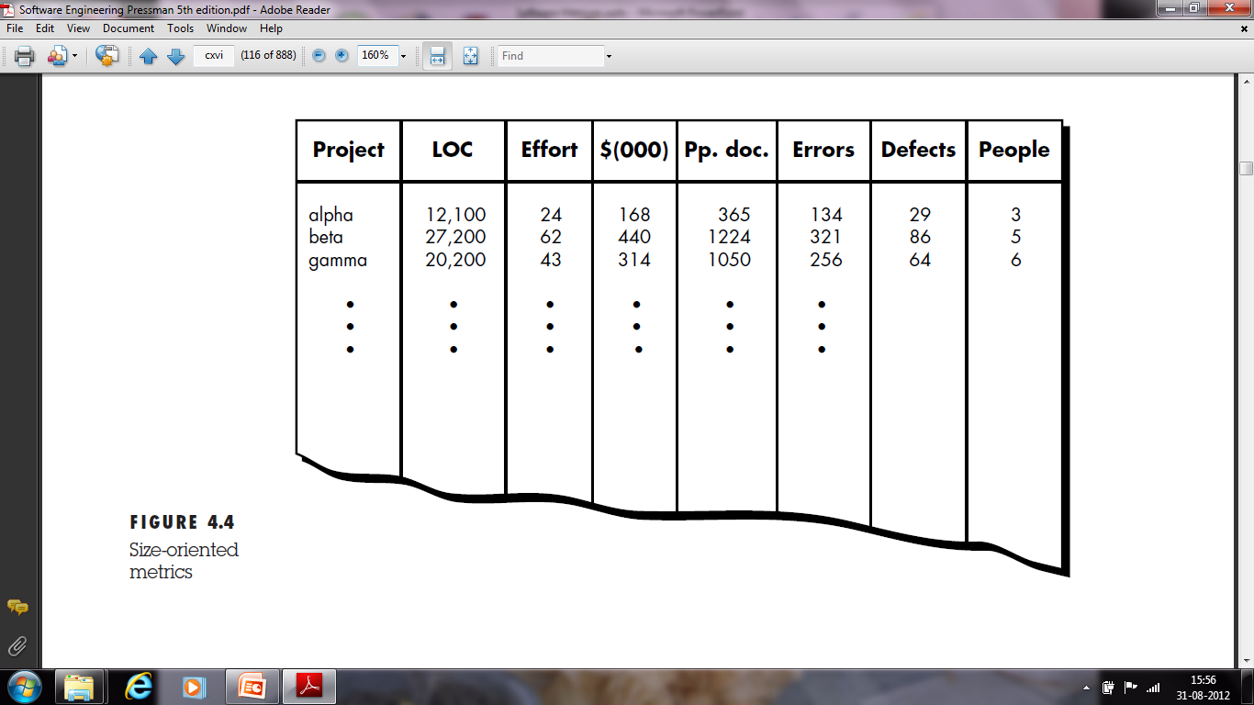

Slide 15
Function-Oriented Metrics
Function-oriented software metrics use a measure of the functionality delivered by the application as a normalization value.
Since ‘functionality’ cannot be measured directly, it must be derived indirectly using other direct measures

Slide 16
Function points
Function points are derived using an empirical relationship based on countable (direct) measures of software's information domain and assessments of software complexity.

Slide 17
Information domain values are defined in the following manner:
Number of user inputs. Each user input that provides distinct application oriented data to the software is counted. Inputs should be distinguished from inquiries, which are counted separately

Slide 18
Number of user outputs
Each user output that provides application oriented information to the user is counted.
In this context output refers to reports, screens, error messages, etc.
Individual data items within a report are not counted separately.

Slide 19
Number of user inquiries.
An inquiry is defined as an on-line input that results in the generation of some immediate software response in the form of an on-line output. Each distinct inquiry is counted

Slide 20
Number of files.
Each logical master file (i.e., a logical grouping of data that may be one part of a large database or a separate file) is counted.

Slide 21
Number of external interfaces.
All machine readable interfaces (e.g., data files on storage media) that are used to transmit information to another system are counted.
Once these data have been collected, a complexity value is associated with each count.

Slide 22
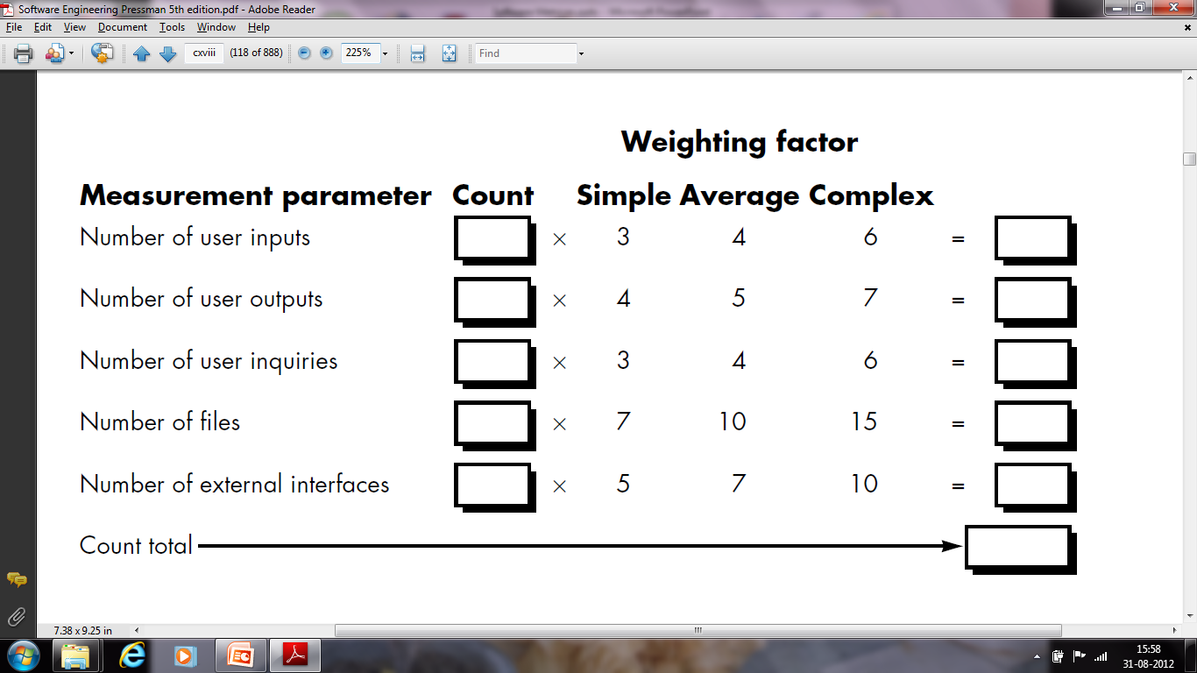

Slide 23
Formula
To compute function points (FP), the following relationship is used:
FP = count total [0.65 + 0.01 Σ(Fi)]
where count total is the sum of all FP entries

Slide 24
The Fi (i = 1 to 14) are "complexity adjustment values" based on responses to the following questions

Slide 25
1. Does the system require reliable backup and recovery?
2. Are data communications required?
3. Are there distributed processing functions?
4. Is performance critical?
5. Will the system run in an existing, heavily utilized operational environment?
6. Does the system require on-line data entry?

Slide 26
7. Does the on-line data entry require the input transaction to be built over multiple screens or operations?
8. Are the master files updated on-line?
9. Are the inputs, outputs, files, or inquiries complex?
10. Is the internal processing complex?

Slide 27
11. Is the code designed to be reusable?
12. Are conversion and installation included in the design?
13. Is the system designed for multiple installations in different organizations?
14. Is the application designed to facilitate change and ease of use by the user?

Slide 28
Each of these questions is answered using a scale that ranges from 0 (not important or applicable) to 5 (absolutely essential).
Once function points have been calculated, they are used in a manner analogous to LOC as a way to normalize measures for software productivity, quality,

Slide 29
and other attributes such as:
• Errors per FP.
• Defects per FP.
• $ per FP.
• Pages of documentation per FP.

Slide 30
Example: Compute the function point, productivity, documentation, cost per function for the following data:
Number of user inputs = 24
Number of user outputs = 46
Number of inquiries = 8
Number of files = 4
Number of external interfaces = 2
Effort = 36.9 p-m
Technical documents = 265 pages
User documents = 122 pages
Cost = $7744/ month
Various processing complexity factors are: 4, 1, 0, 3, 3, 5, 4, 4, 3, 3, 2, 2, 4, 5.

Slide 31


Solution:
So sum of all f_{i} (i ← 1 to 14) = 4 + 1 + 0 + 3 + 5 + 4 + 4 + 3 + 3 + 2 + 2 + 4 + 5 = 43
FP = Count-total * [0.65 + 0.01 *∑(f_{i})] = 378 * [0.65 + 0.01 * 43] = 378 * [0.65 + 0.43] = 378 * 1.08 = 408
Total pages of documentation = technical document + user document = 265 + 122 = 387pages
Documentation = Pages of documentation/FP = 387/408 = 0.94
Measurement Parameter | Count |  | Weighing factor
1. Number of external inputs (EI) | 24 | * | 4 = 96
2. Number of external outputs (EO) | 46 | * | 4 = 184
3. Number of external inquiries (EQ) | 8 | * | 6 = 48
4. Number of internal files (ILF) | 4 | * | 10 = 40
5. Number of external interfaces (EIF) Count-total → | 2 | * | 5 = 10 378

Slide 32
METRICS FOR SOFTWARE QUALITY
The overriding goal of software engineering is to produce a high-quality system, application, or product.
In addition to other activities , a good software engineer (and good software engineering managers) must measure if high quality is to be realized.

Slide 33
The quality of a system, application, or product is only as good as the requirements that describe the problem, the design that models the solution, the code that leads to an executable program, and the tests that exercise the software to uncover errors.
A good software engineer uses measurement to assess the quality of the analysis and design models, the source code, and the test cases that have been created as the software is engineered.

Slide 34
The project manager must also evaluate quality as the project progresses.
Although many quality measures can be collected, the primary thrust at the project level is to measure errors and defects. Metrics derived from these measures provide an indication of the effectiveness of individual and group software quality assurance and control activities.

Slide 35
An Overview of Factors That Affect Quality
Over 25 years ago, McCall and Cavano defined a set of quality factors that were a first step toward the development of metrics for software quality.
These factors assess software from three distinct points of view:
(1) product operation (using it)
(2) product revision (changing it)
(3) product transition (modifying it to work
in a different environment; i.e., "porting" it).

Slide 36
First, the framework provides a mechanism for the project manager to identify what qualities are important.
Secondly, the framework provides a means for quantitatively assessing how well the development is progressing relative to the quality goals established.

Slide 37
Thirdly, the framework provides for more interaction of QA personnel throughout the development effort.
Lastly, quality assurance personal can use indications of poor quality to help identify better standards to be enforced in the future.

Slide 38
Measuring Quality
Correctness
Maintainability
Integrity
Usability

Slide 39
Correctness
Correctness is the degree to which the software performs its required function. The most common measure for correctness is defects per KLOC.
For quality assessment purposes, defects are counted over a standard period of time, typically one year.

Slide 40
Maintainability.
Maintainability is the ease with which a program can be corrected if an error is encountered, adapted if its environment changes, or enhanced if the customer desires a change in requirements.
There is no way to measure maintainability directly; therefore, we must use indirect measures.

Slide 41
A simple time-oriented metric is mean-time-to change (MTTC), the time it takes to analyze the change request, design an appropriate modification, implement the change, test it, and distribute the change to all users.
On average, programs that are maintainable will have a lower MTTC (for equivalent types of changes) than programs that are not maintainable.

Slide 42
Integrity
This attribute measures a system's ability to withstand attacks (both accidental and intentional) to its security. Attacks can be made on all three components of software: programs, data, and documents

Slide 43
To measure integrity, two additional attributes must be defined: threat and security.
Threat is the probability that an attack of a specific type will occur within a given time.

Slide 44
Security is the probability that the attack of a specific type will be repelled.
The integrity of a system can then be defined as
integrity = summation [(1 – threat) (1 – security)]

Slide 45
Usability.
If a program is not user-friendly, it is often doomed to failure,
Usability is an attempt to quantify user-friendliness and can be measured in terms of four characteristics:

Slide 46
(1) the physical and or intellectual skill required to learn the system,
(2) the time required to become moderately efficient in the use of the system,
(3) the net increase in productivity (over the approach that the system replaces) measured when the system is used by someone who is moderately efficient, and

Slide 47
(4) a subjective assessment (sometimes obtained through a questionnaire) of users attitudes toward the system

Slide 48
INTEGRATING METRICS WITHIN THE SOFTWARE PROCESS
If we do not measure, there no real way of determining whether we are improving.
By requesting and evaluating productivity and quality measures, senior management can establish meaningful goals for improvement of the software engineering

Slide 49
Establishing a Baseline
By establishing a metrics baseline, benefits can be obtained at the process, project, and product (technical) levels.

Slide 50
To be an effective aid in process improvement and/or cost and effort estimation, baseline data must have the following attributes:
(1) data must be reasonably accurate—“
(2) data should be collected for as many projects as possible;
(3) measures must be consistent

Slide 51
Metrics Collection, Computation, and Evaluation
Ideally, data needed to establish a baseline has been collected in an ongoing manner.
data collection requires a historical investigation of past projects to reconstruct required data.

Slide 52
The Process
Once measures have been collected metrics computation is possible.
Depending on the breadth of measures collected, metrics can span a broad range of LOC or FP metrics as well as other quality- and project-oriented metrics.
Finally, metrics must be evaluated and applied during estimation, technical work, project control, and process improvement.

Slide 53
Metrics evaluation focuses on the underlying reasons for the results obtained and produces a set of indicators that guide the project or process.

